Slide 1
Banner Applications and Kubernetes
May, 6, 2023

Slide 2
What We Will Cover
Why
How
Results

Slide 3
Tell Me Why
Scalability
Built-in Health Checks
Built-in Monitoring
Easy scripting for bringing everything up or down

Slide 4
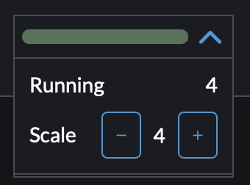

Slide 5
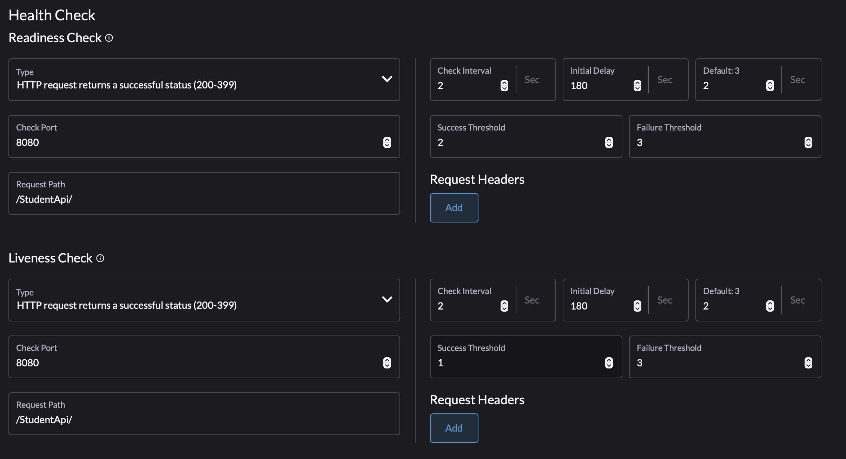
Health Checks

Slide 6
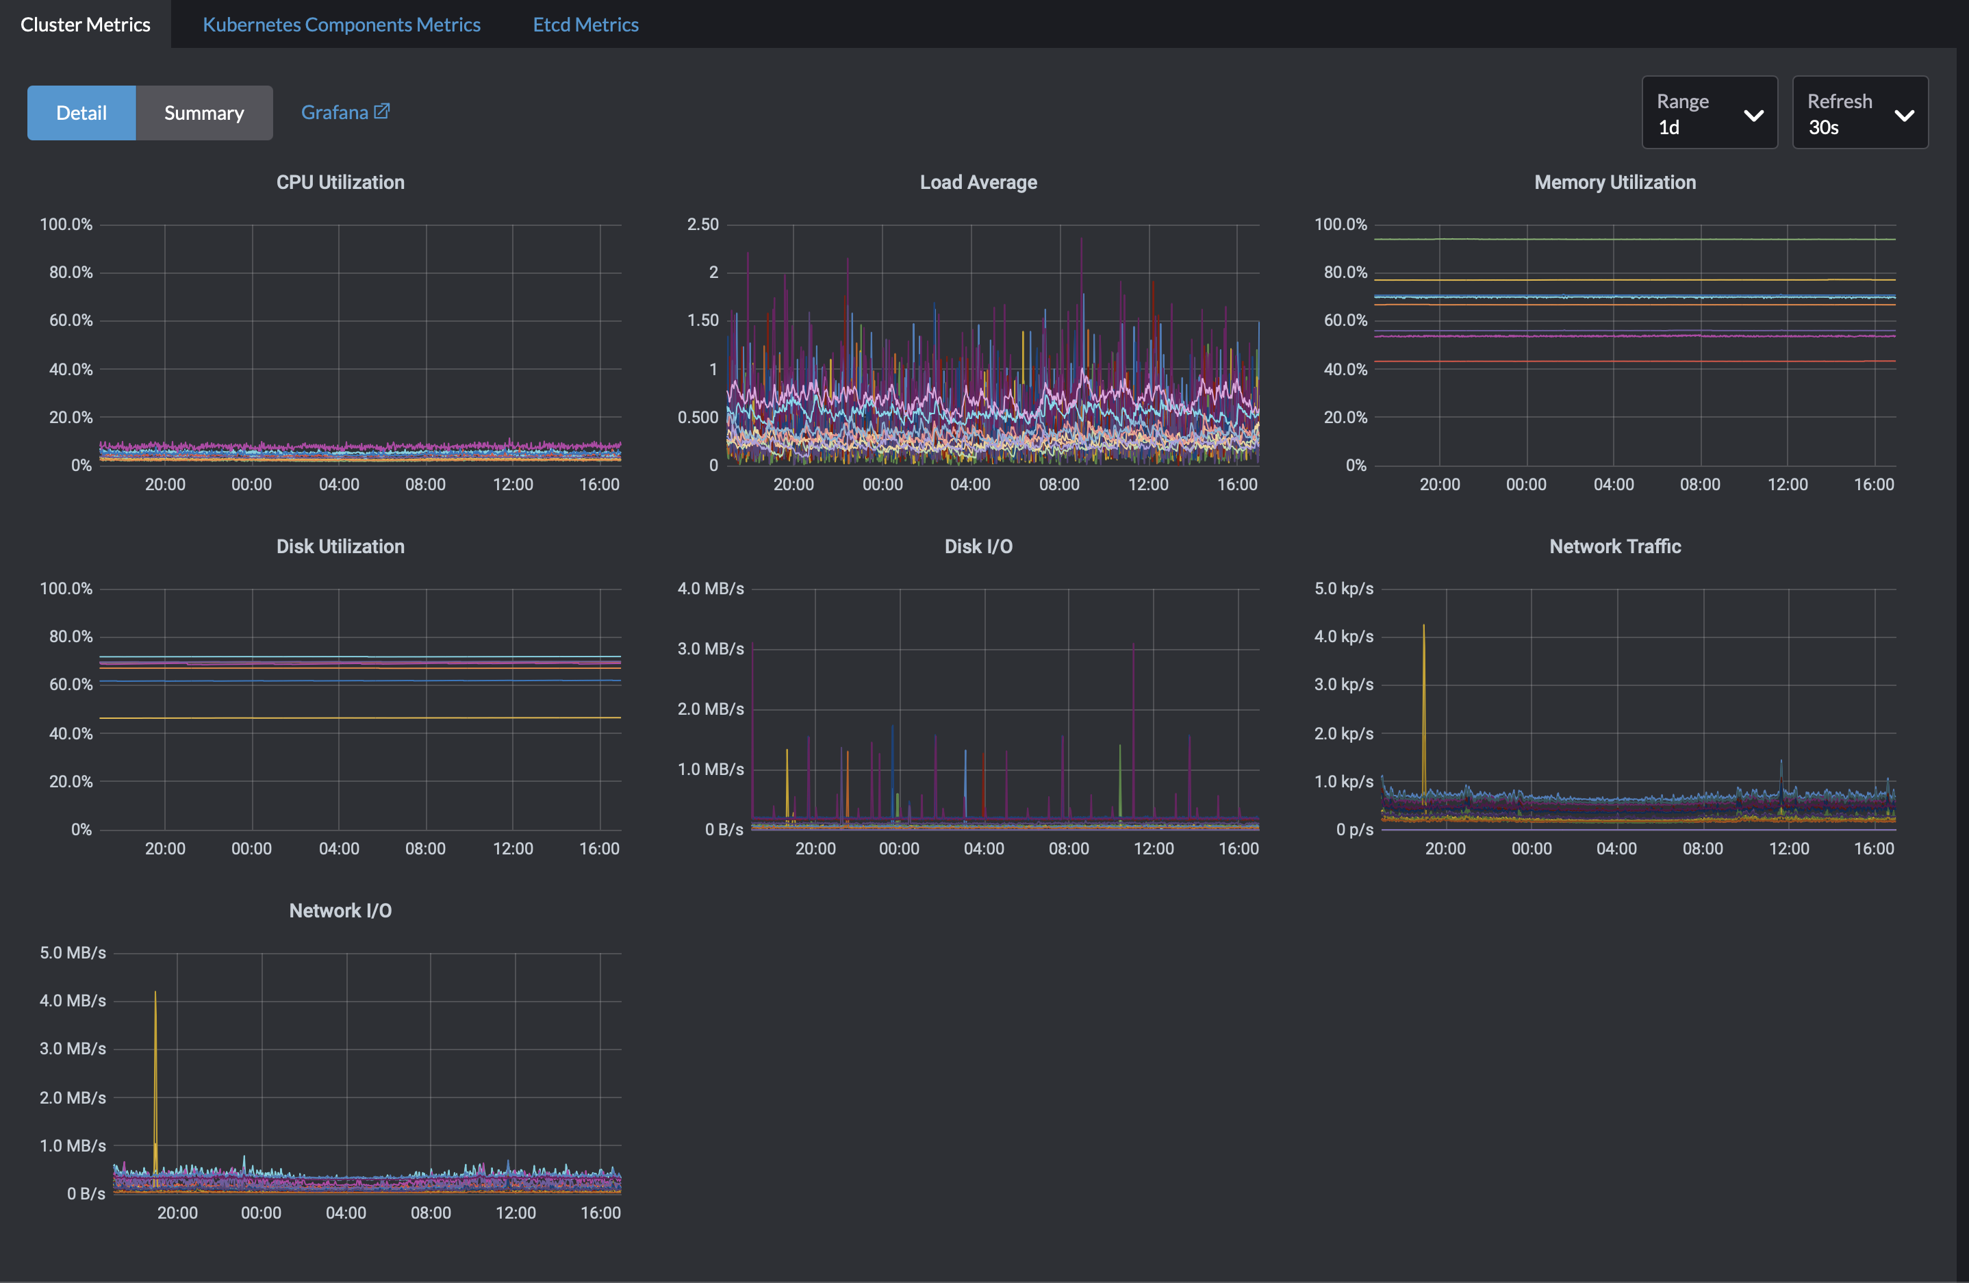

Slide 7
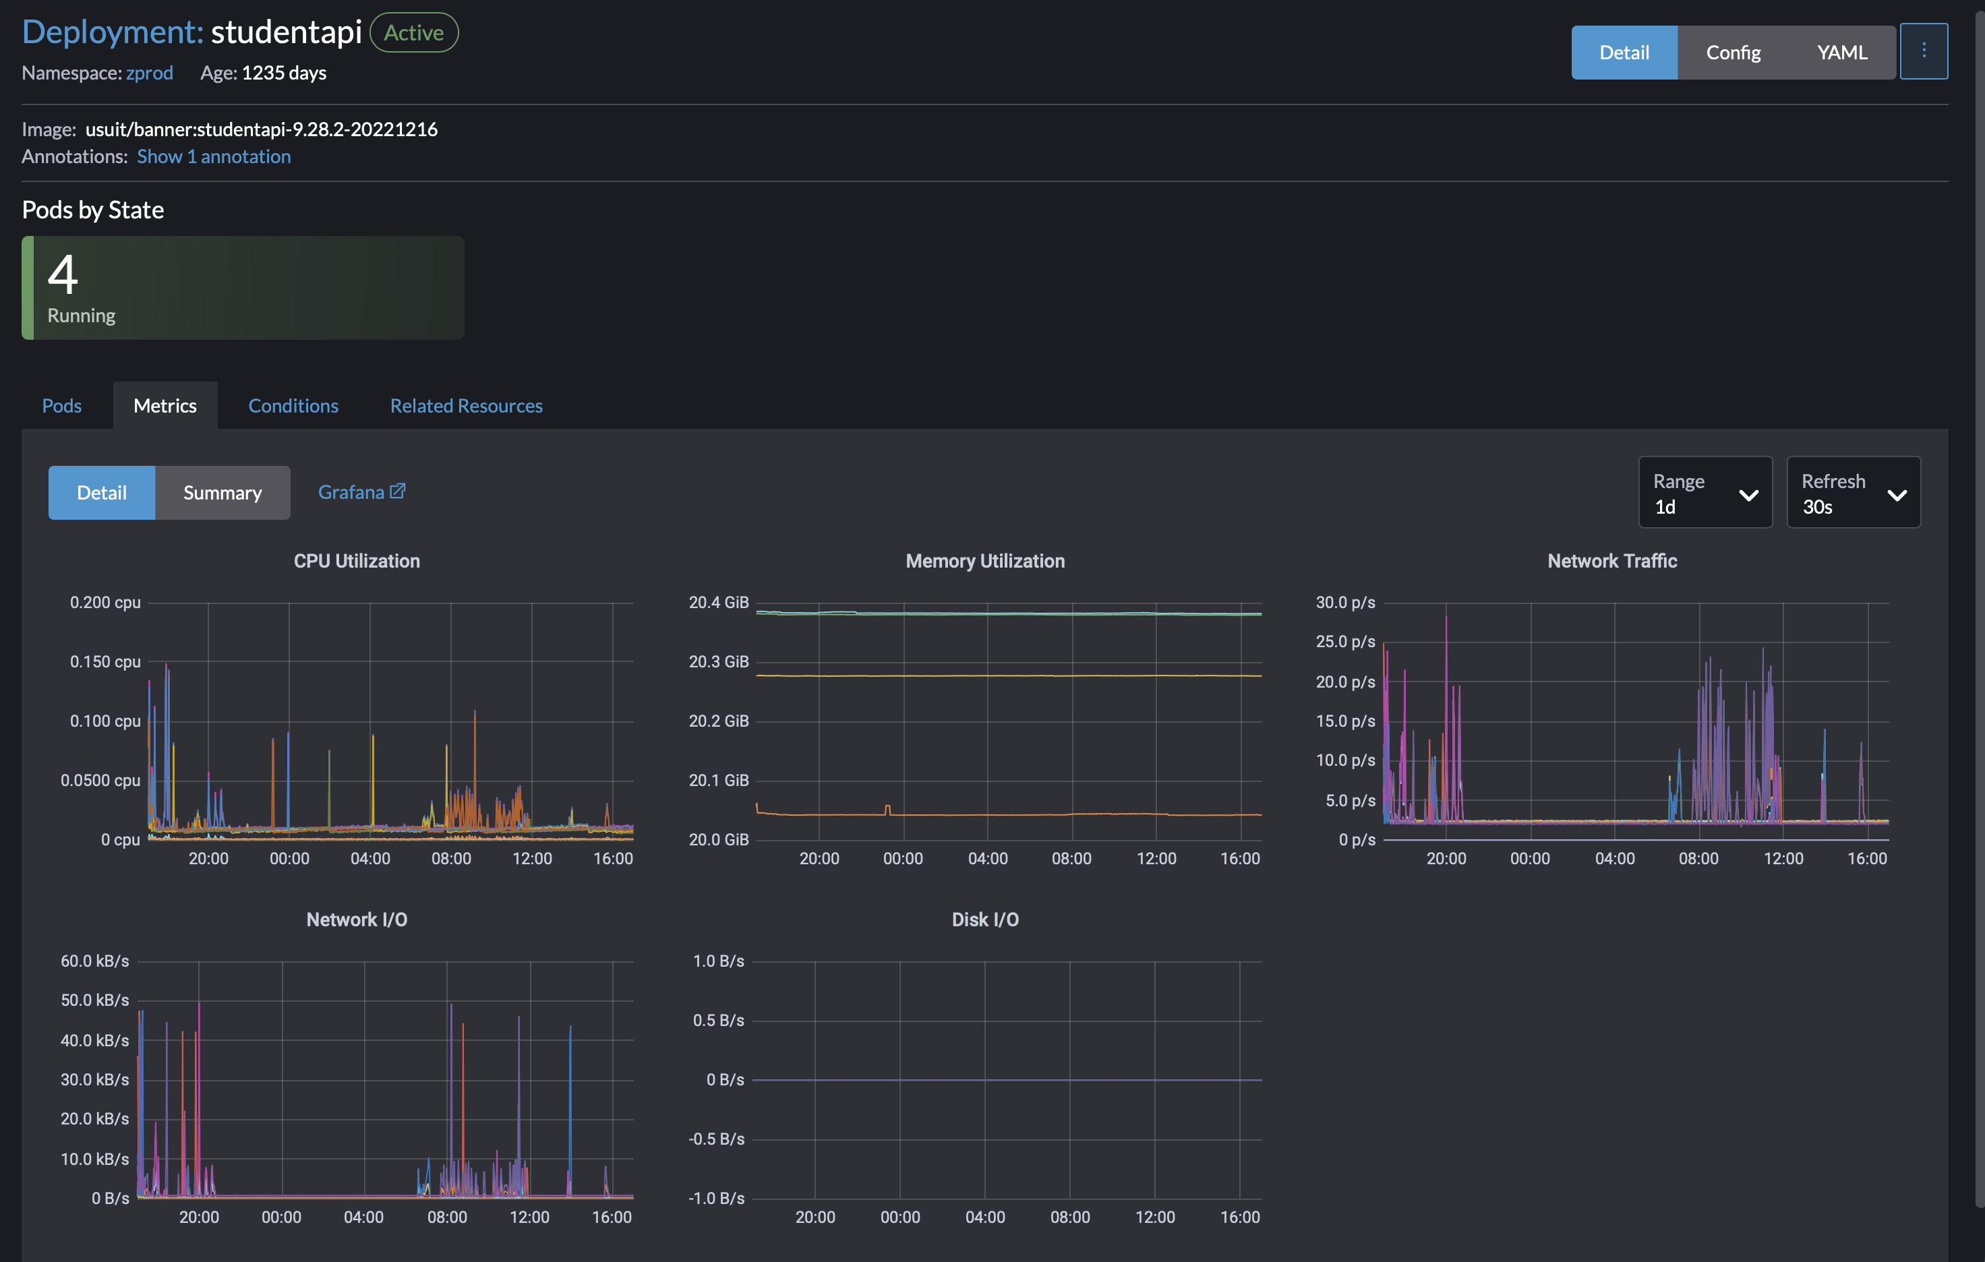

Slide 8
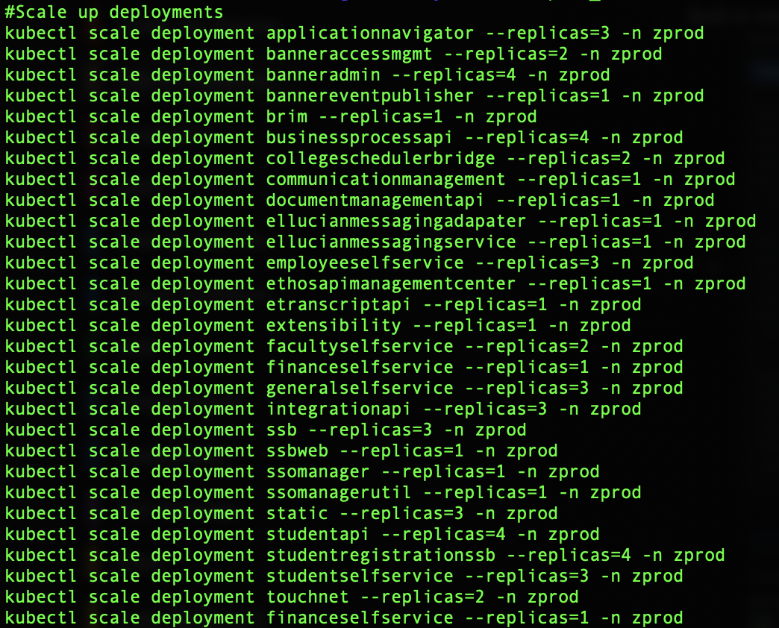

Slide 9
Tell Me How
Setup Linux Nodes
3 are required for k8s on RKE
We use Ubuntu
Setup Local Environment
Kubectl, RKE, Helm
Install Rancher with Helm
Create Banner cluster
Create deployments

Slide 10
Setup Linux Nodes
Install Supported Distribution
https://www.suse.com/suse-rke1/support-matrix/all-supported-versions/rke1-v1-25
Linux with Docker installed
curl https://releases.rancher.com/install-docker/20.10.sh | sh
SSH key to use on each node
Rancher needs SSH
Generate key on your machine
Add public key to authorized_keys on every host
Rancher user needs to be member of docker group

Slide 11
Setup Local Environment
Install Tools (Homebrew makes it easy on a Mac!)
RKE - brew install rke
Kubectl - brew install kubectl
Helm - brew install helm
Create rancher-cluster.yml

Slide 12
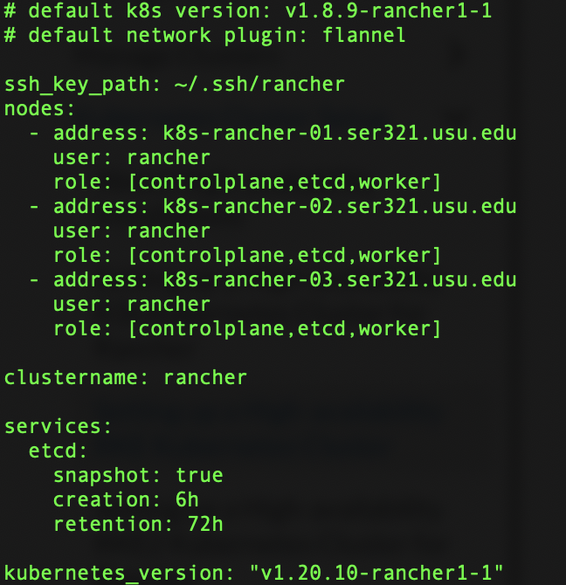
rancher-cluster.yml

Slide 13
Install Rancher with Helm
Run RKE up
rke up --config ./rancher-cluster.yml
Kubernetes cluster is created
Test Cluster with Kubectl
export KUBECONFIG=$(pwd)/kube_config_cluster.yml
kubectl get nodes
kubectl get pods --all-namespaces
kubectl create namespace cattle-system

Slide 14
Install Rancher with Helm
Run Helm
helm repo add rancher-stable https://releases.rancher.com/server-charts/stable
helm install rancher rancher-stable/rancher \
﻿﻿--namespace cattle-system \
﻿--set hostname=rancher.usu.edu \
﻿﻿--set bootstrapPassword=admin \
﻿--set ingress.tls.source=secret
Rancher interface should be available at hostname after a few minutes

Slide 15
Create Banner Cluster
Setup at least 3 Linux nodes
Can also plug directly in to
Managed Kubernetes providers
Amazon EC2
Azure
Digital Ocean
vSphere
We have always used Custom option or import existing cluster

Slide 16
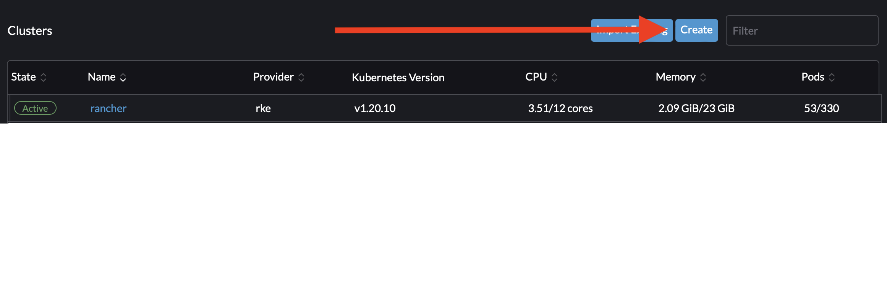
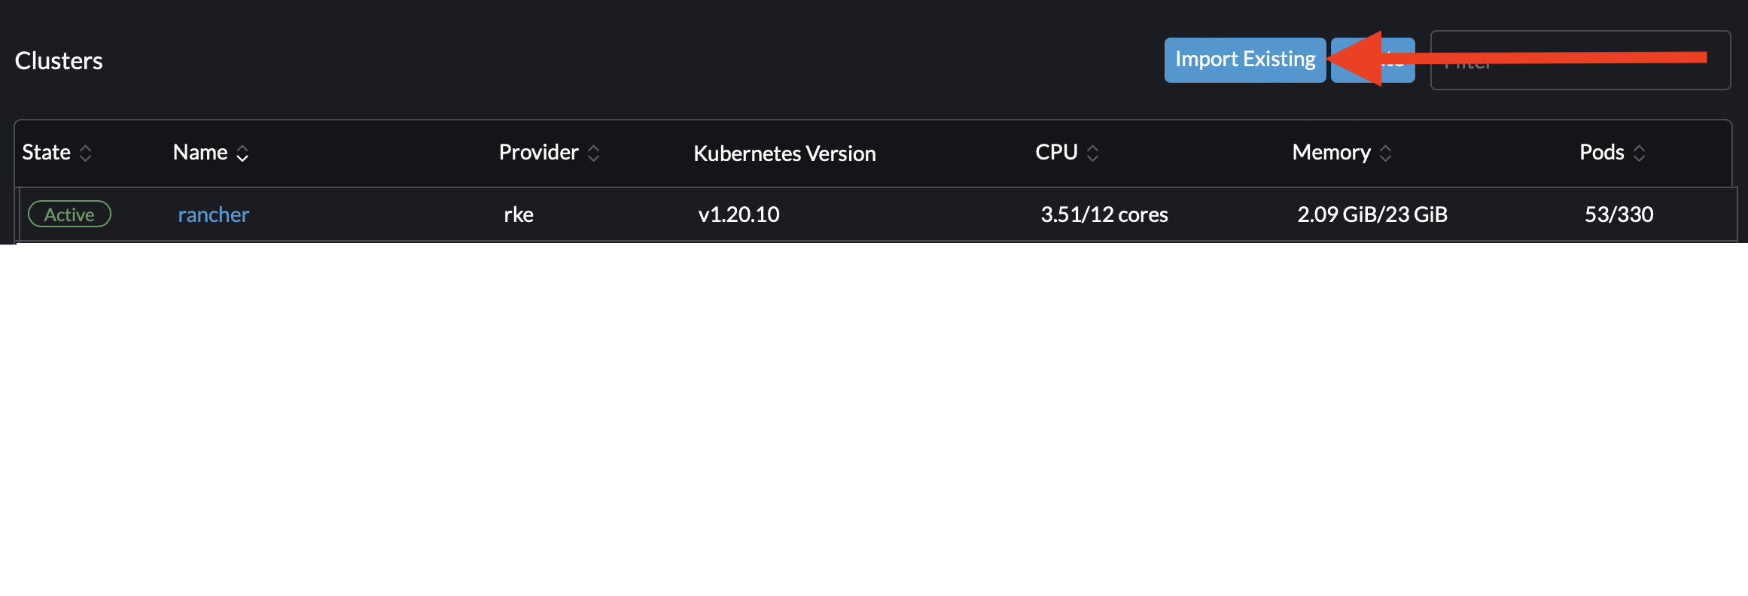
or

Slide 17
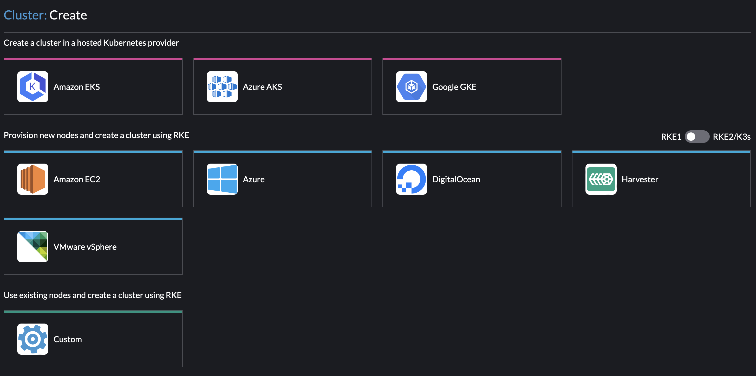

Slide 18
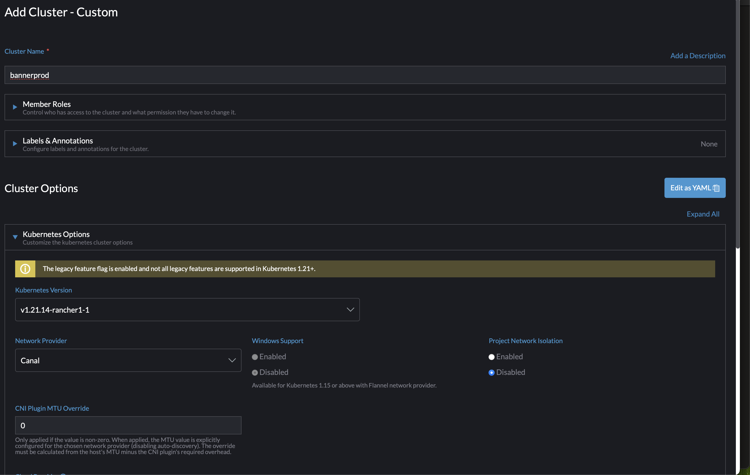

Slide 19
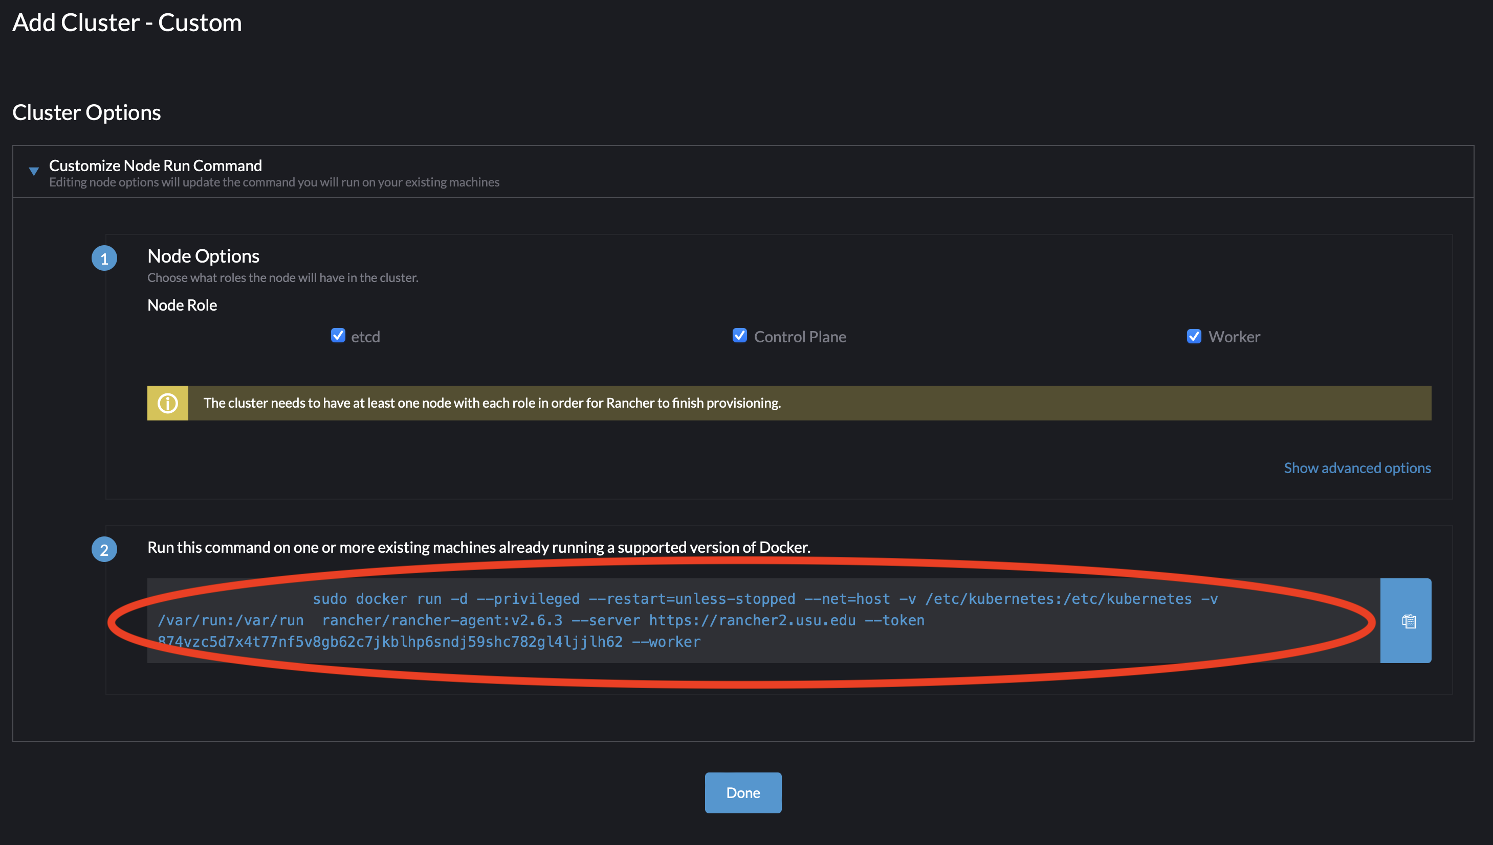

Slide 20
Create Deployments
Create Base Image
Separate base for banner admin and self service
Get War file from source tree
We run deployment in ESM and get resulting War file
Build application docker image
Push image to repository
Setup deployment in Rancher

Slide 21
Create Base Image
Build Base Dockerfile
Need ojdbc8.jar and xdb6.jar
https://www.oracle.com/database/technologies/appdev/jdbc-drivers-archive.html
ojdbc8-full.tar.gz
We probably need to review this - still using Oracle 12c JDBC Drivers
Need context.xml, server.xml, and run.sh
We used edurepo at bitbucket.org as starting point
https://bitbucket.org/edurepo/banner9-admin/src/openjdk/tomcat8.5/corretto8-amazonlinux2/
https://bitbucket.org/edurepo/banner9-selfservice/src/openjdk/tomcat8.5/corretto-amazonlinux2/

Slide 22
FROM tomcat:9.0.71-jdk8-corretto
ENV TIMEZONE="America/New_York"
ENV XMS=2g XMX=4g BANNERDB_JDBC=jdbc:oracle:thin:@//oracle.example.edu:1521/prod \
MAXMETASPACE=512m \
BANPROXY_USERNAME=banproxy \
BANPROXY_INITALSIZE=25 \
BANPROXY_MAXTOTAL=400 \
BANPROXY_MAXIDLE=-1 \
BANPROXY_MAXWAIT=30000 \
BANSSUSER_USERNAME=ban_ss_user \
BANSSUSER_INITALSIZE=25 \
BANSSUSER_MAXTOTAL=400 \
BANSSUSER_MAXIDLE=-1 \
BANSSUSER_MAXWAIT=30000 \
REMOVE_ABANDONED_ON_MAINTENANCE=true \
REMOVE_ABANDONED_ON_BORROW=true \
REMOVE_ABANDONED_TIMEOUT=2100 \
LOG_ABANDONED=true \
DEFAULT_ROW_PREFETCH=150 \
LOGGING_DIR=/usr/local/tomcat/logs
ENV CATALINA_OPTS="-server -Xms\$XMS -Xmx\$XMX -XX:MaxMetaspaceSize=\$MAXMETASPACE -Duser.timezone=\$TIMEZONE -Doracle.jdbc.autoCommitSpecCompliant=false -Dbanner.logging.dir=\$LOGGING_DIR"
RUN yum update -y \
&& amazon-linux-extras install epel \
&& yum install -y xmlstarlet shadow-utils \
&& rm -Rf /usr/local/tomcat/webapps/* \
&& cp /usr/share/zoneinfo/$TIMEZONE /etc/localtime \
&& groupadd -r tomcat && useradd -r -g tomcat tomcat
ADD ojdbc8.jar /usr/local/tomcat/lib/ojdbc8.jar
ADD xdb6.jar /usr/local/tomcat/lib/xdb6.jar
RUN cd /usr/local/tomcat/lib/ \
&& chown tomcat:tomcat ojdbc8.jar xdb6.jar && chmod +r ojdbc8.jar xdb6.jar
COPY context.xml /usr/local/tomcat/conf/context.xml
COPY server.xml /usr/local/tomcat/conf/server.xml
COPY run.sh /usr/local/tomcat/bin
# Configure logging to forward tomcat logs to docker log collector
COPY logging.properties /usr/local/tomcat/conf/logging.properties
RUN ln -s /dev/stderr /usr/local/tomcat/logs/localhost.log
RUN ln -s /dev/stderr /usr/local/tomcat/logs/stacktrace.log
RUN mkdir -p /opt/banner/config && mkdir -p /opt/banner/images && chown -R tomcat:tomcat /opt/banner
RUN chown -R tomcat:tomcat /usr/local/tomcat && chmod +x /usr/local/tomcat/bin/run.sh
EXPOSE 8080
USER tomcat
CMD ["bin/run.sh"]

Slide 23
Create Base Image
Build Command
docker build --platform linux/amd64 -t usuit/banner:base-bannerselfservice-9.0.71-jdk8-corretto .
(Use your own private docker repo instead of usuit)
Push Command
docker push usuit/banner:base-bannerselfservice-9.0.71-jdk8-corretto
Will use this image to create images for each application

Slide 24
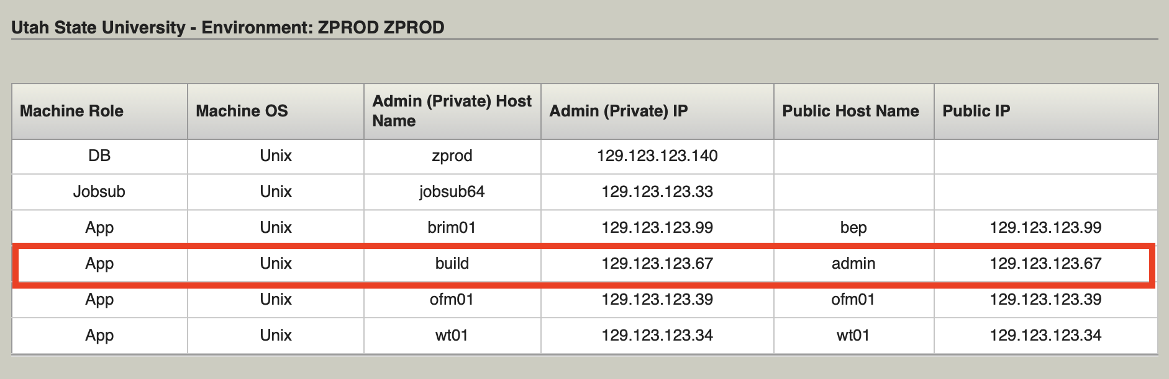
Get War From Source Tree
We have a machine ESM thinks is a Tomcat server (It isn’t)

Slide 25
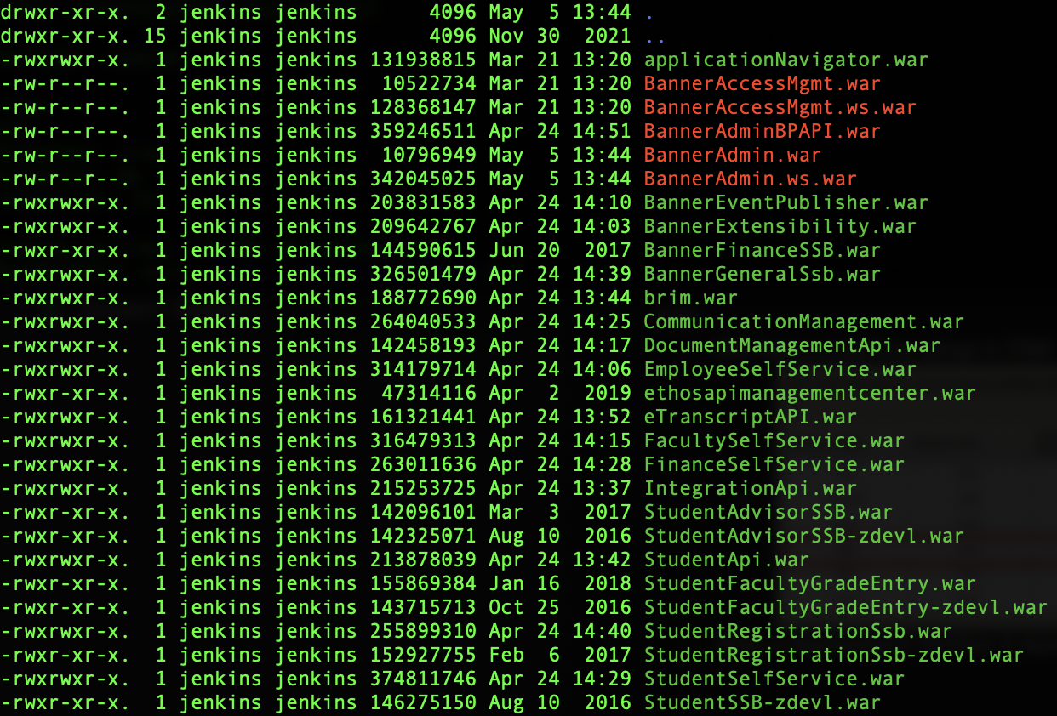
Get War From Source Tree

Slide 26
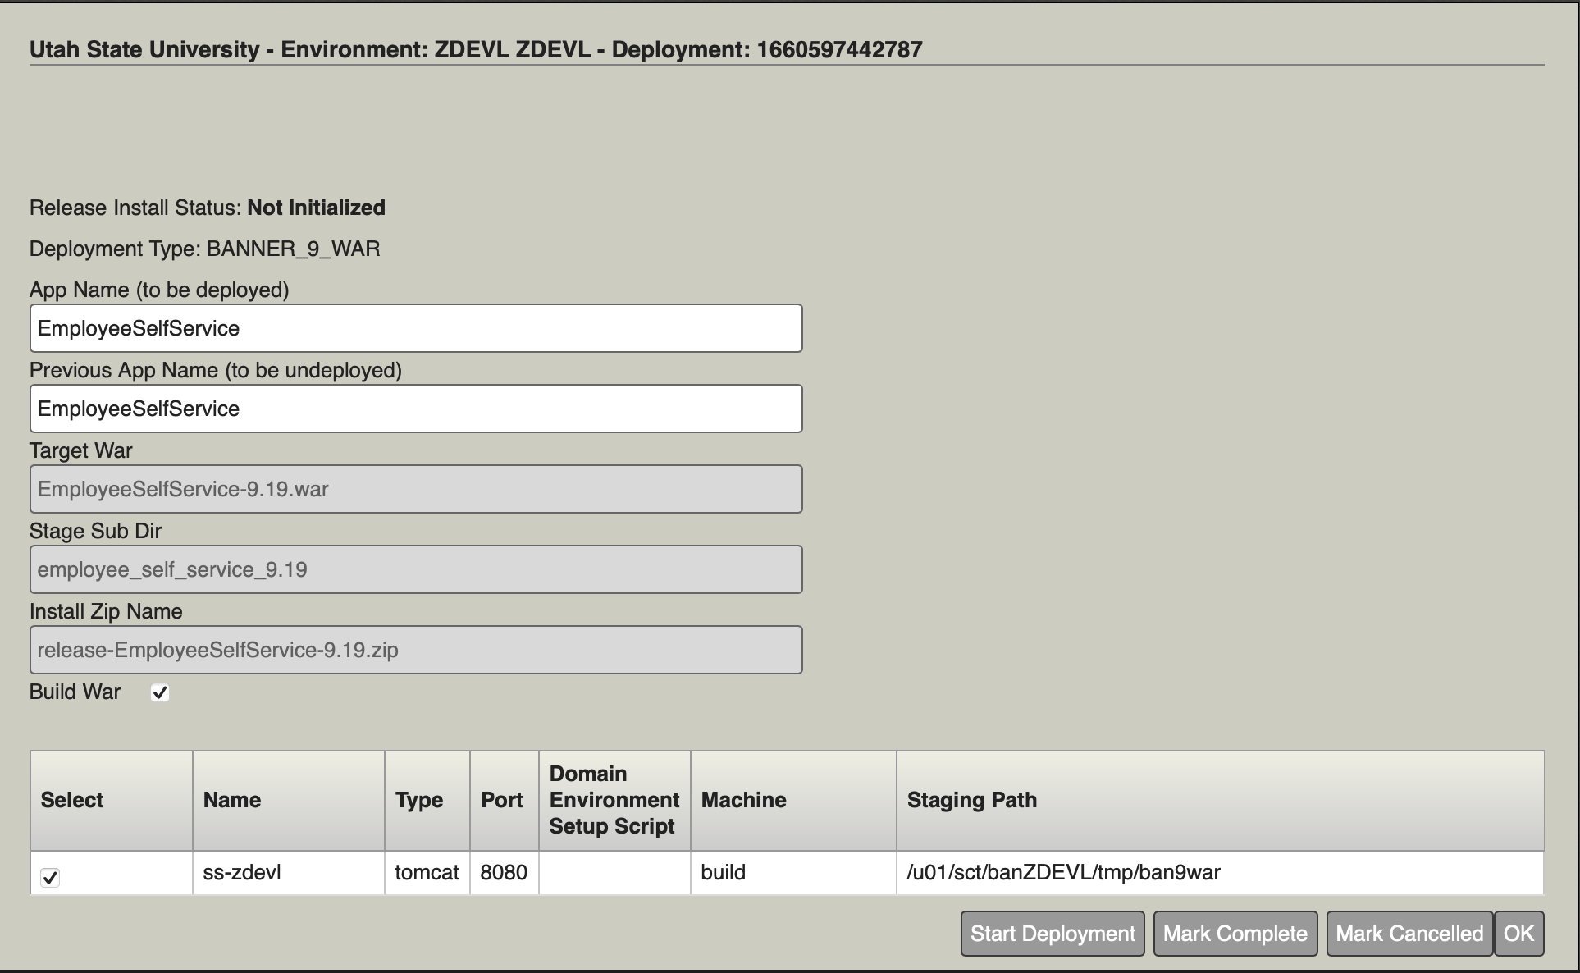
Get War From Source Tree
We run the deployment and it dumps the file to the build box

Slide 27
Build Application Docker Image
Our code is at https://github.com/utahstate/banner
Prep.sh file in each folder
Grabs war file from build server
Extracts it
Adds our custom groovy files to application
Custom groovy files
Placeholders for environment variables to be injected

Slide 28
Build Application Docker Image
Build flow
cd to desired folder in repo (i.e. banner/employeeselfservice)
./prep.sh
docker build --platform linux/amd64 -t usuit/banner:employeeselfservice-9.22.1-20230424 .
docker push usuit/banner:employeeselfservice-9.22.1-20230424

Slide 29
Build Application Docker Image
Example Dockerfile
FROM usuit/banner:base-bannerselfservice-9.0.71-jdk8-corretto
LABEL version="9.22"
ENV TIMEZONE=America/Denver
COPY --chown=tomcat:tomcat EmployeeSelfService /usr/local/tomcat/webapps/EmployeeSelfService
COPY --chown=tomcat:tomcat saml /usr/local/tomcat/webapps/EmployeeSelfService/saml

Slide 30
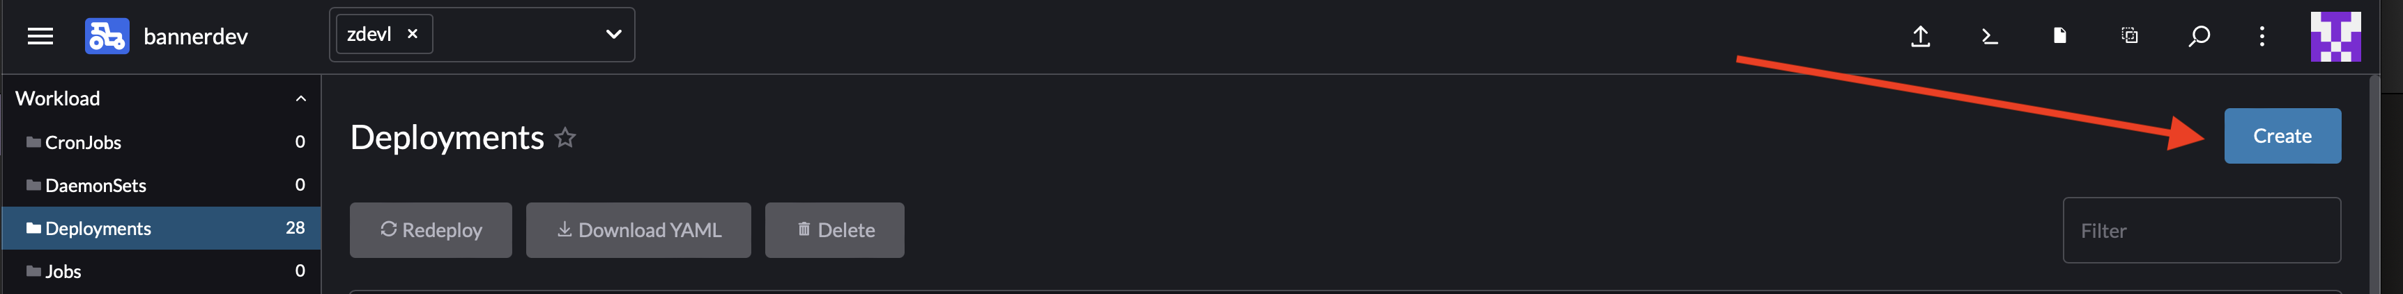
Setup Deployment in Rancher
Create Project and Namespace
Create Deployment

Slide 31
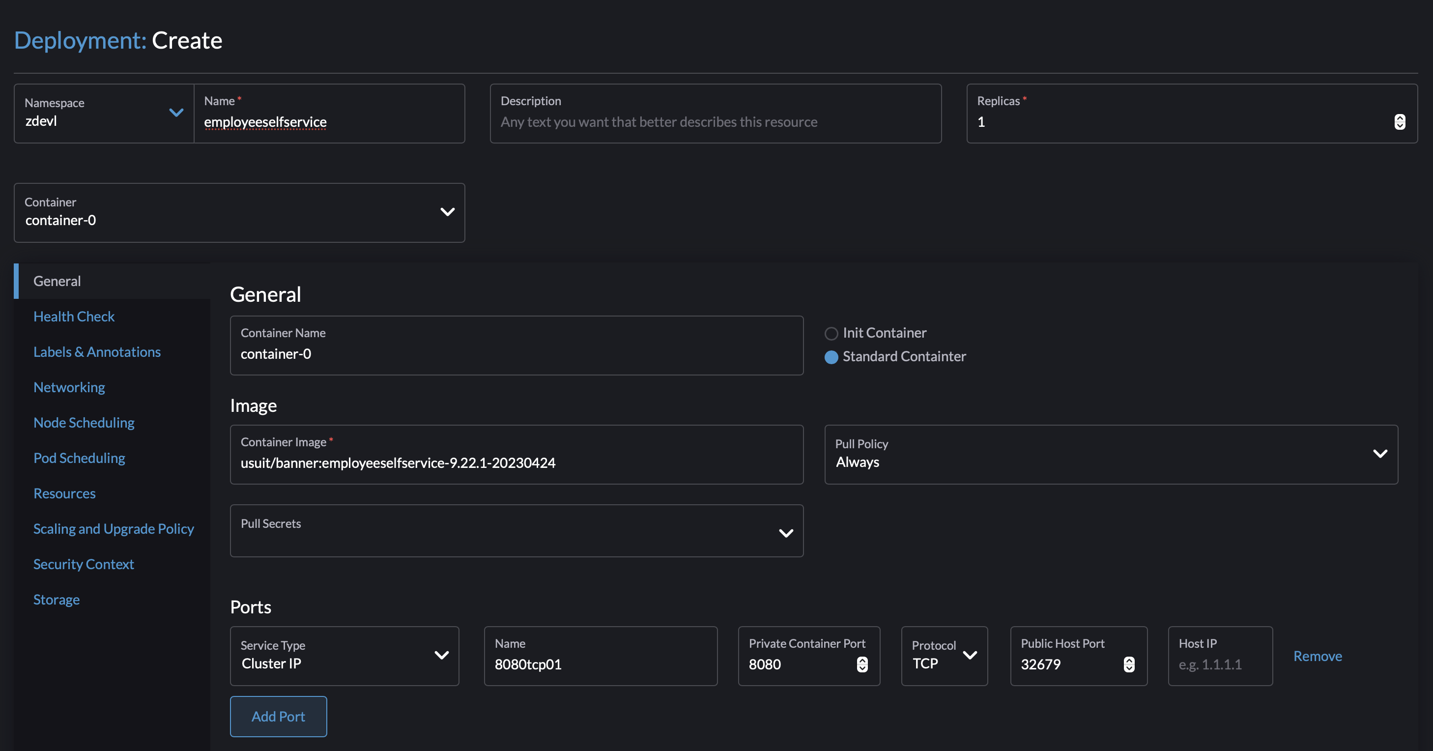

Slide 32
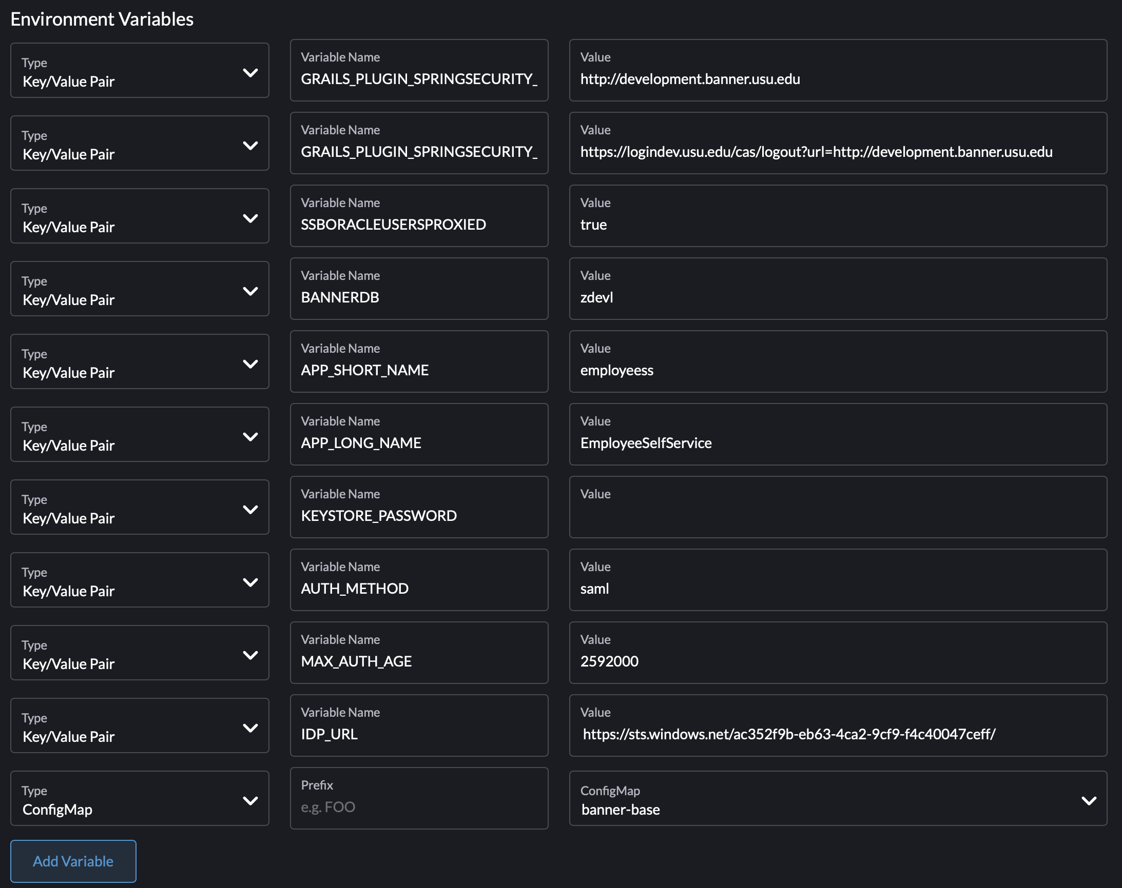

Slide 33
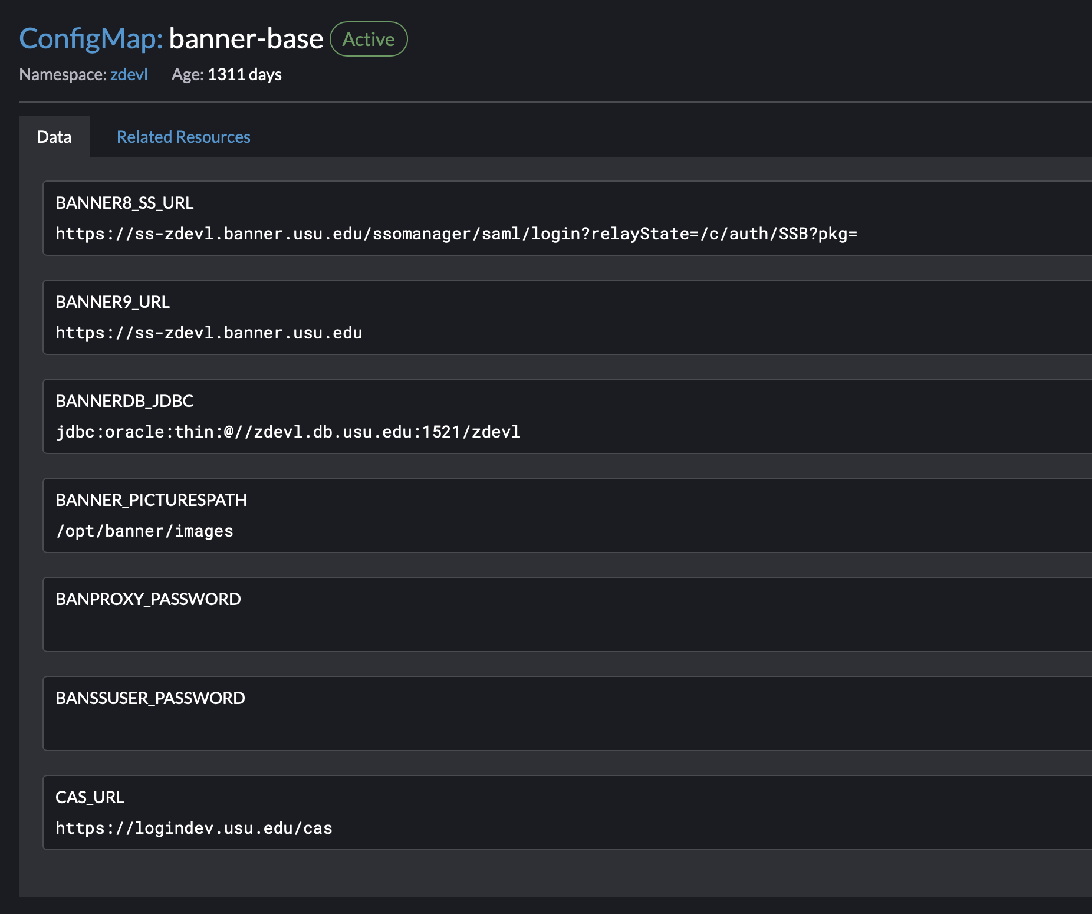

Slide 34
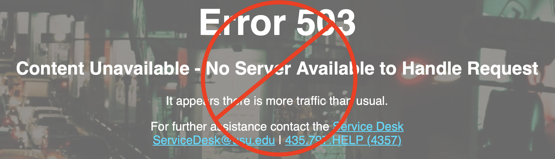
Tell Me the Results
Stability!

Slide 35
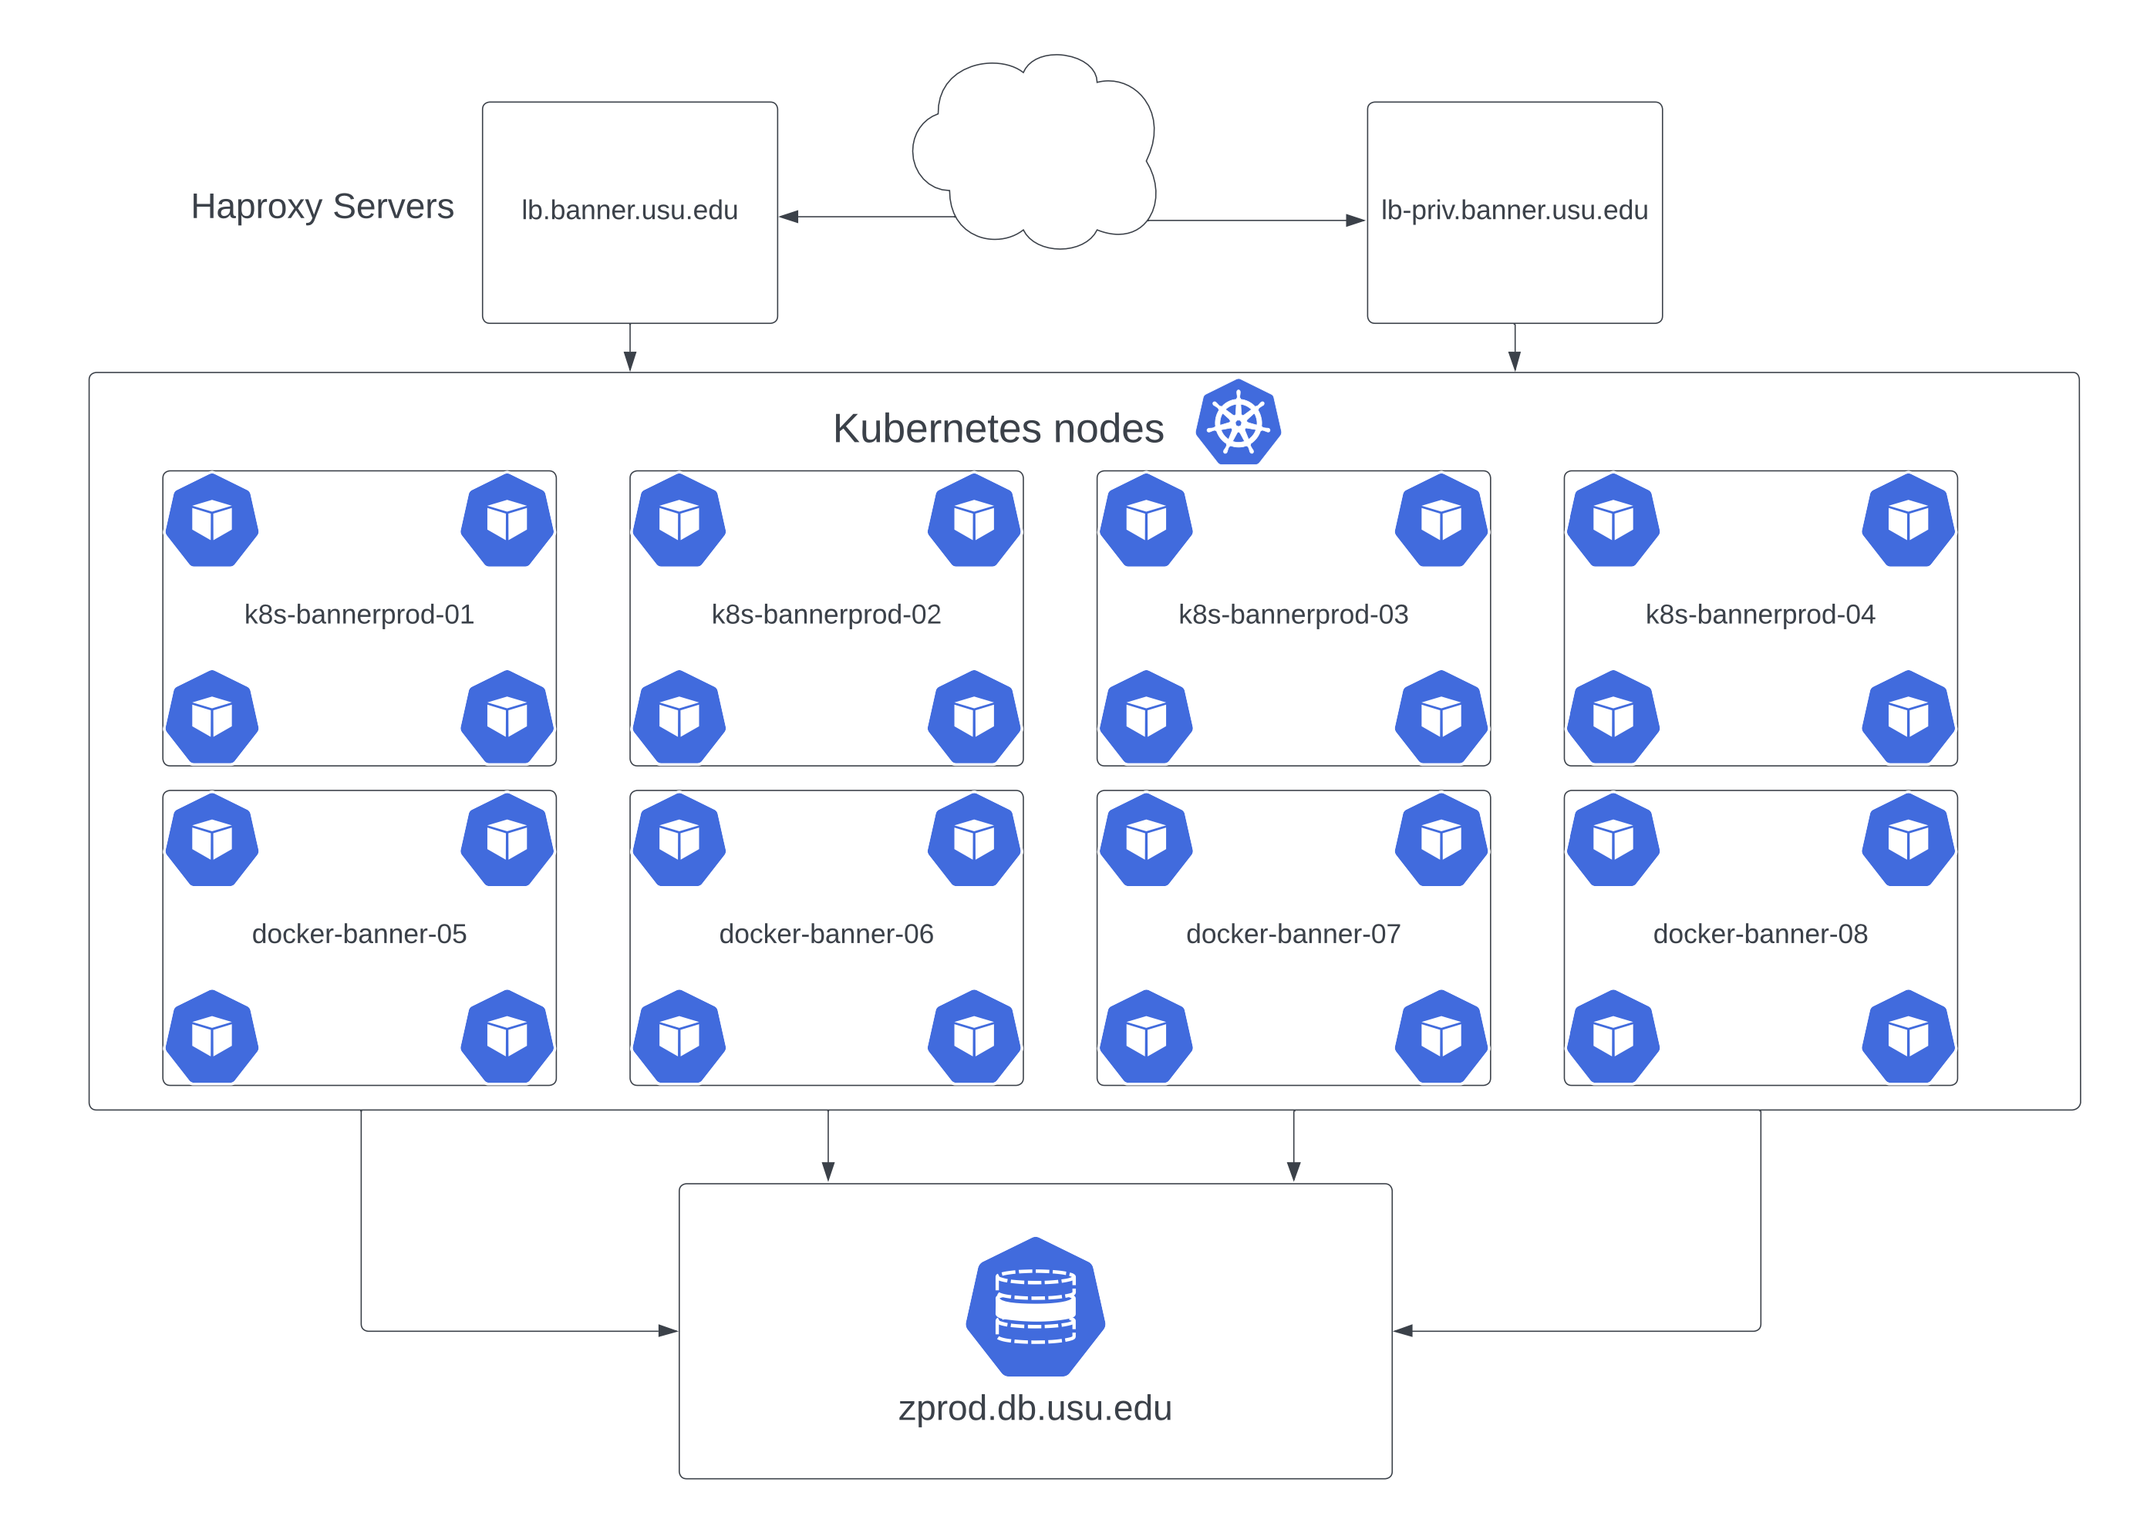

Slide 36
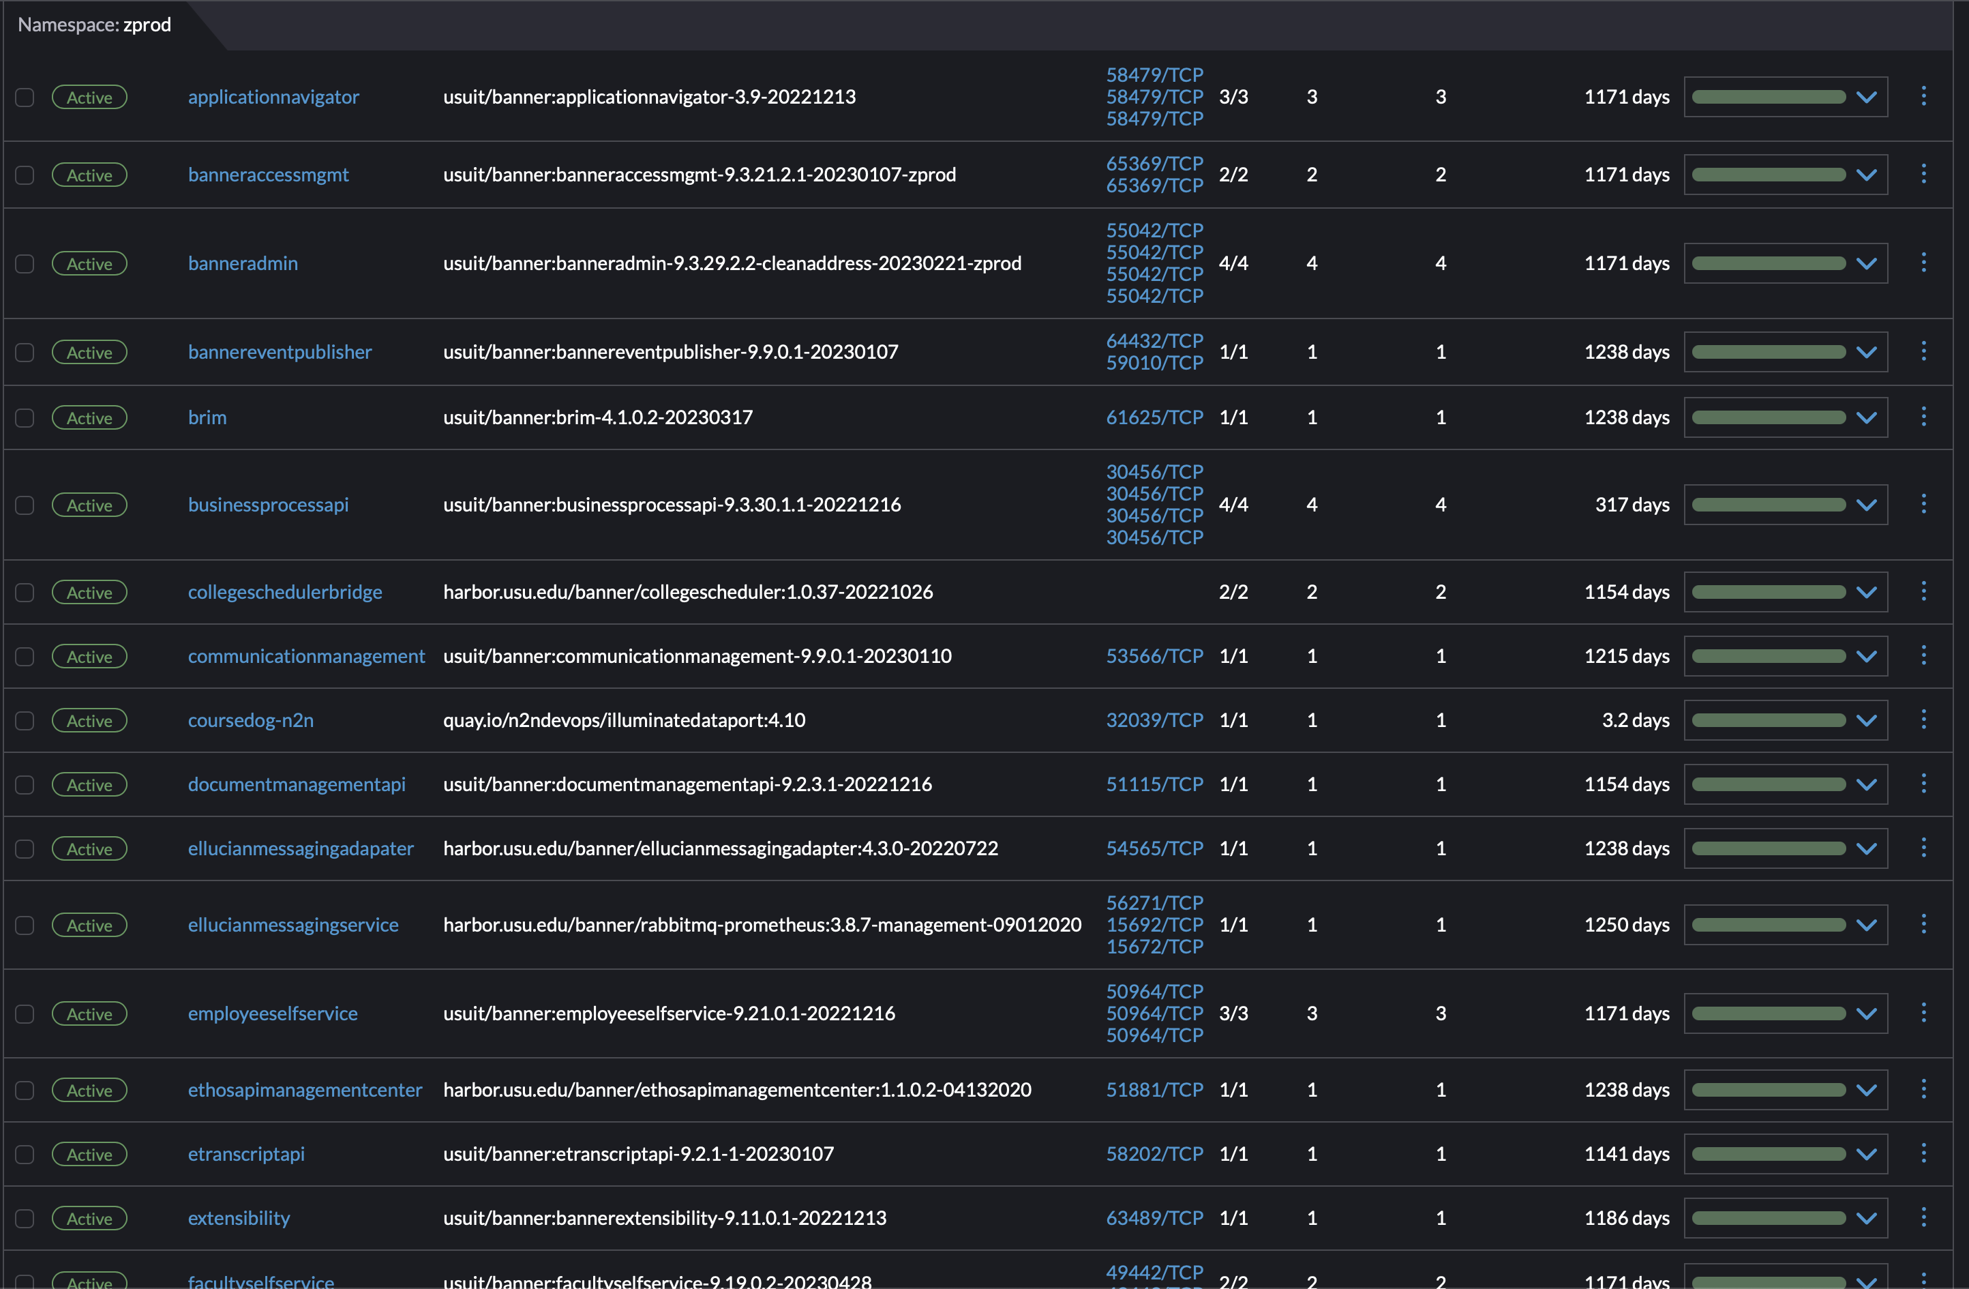

Slide 37
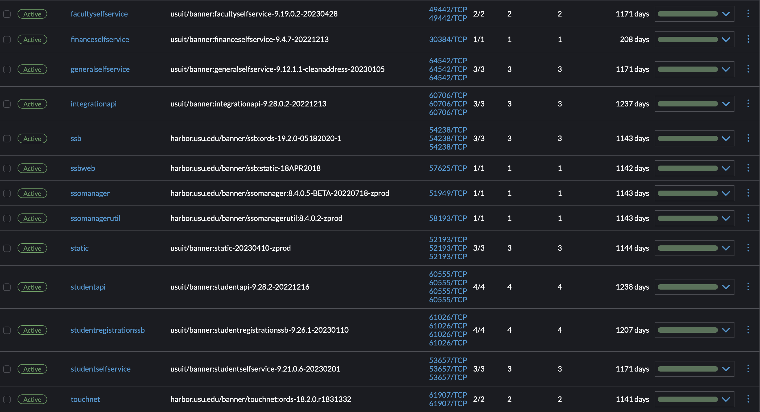

Slide 38
Goals
Automation
Pretty sure we could implement full CI/CD
Could have one master prep.sh file that takes arguments
Cloud
Starting to play with ECS/EKS in AWS
Integrated Ingress Controller
Could potentially retire haproxy load balancers

Slide 39
Questions

Slide 40
References
https://ranchermanager.docs.rancher.com/how-to-guides/new-user-guides/kubernetes-cluster-setup/rke1-for-rancher
https://www.suse.com/suse-rke1/support-matrix/all-supported-versions/rke1-v1-25
https://bitbucket.org/edurepo/banner9-selfservice/src/openjdk/tomcat8.5/corretto-amazonlinux2/
https://bitbucket.org/edurepo/banner9-admin/src/openjdk/tomcat8.5/corretto8-amazonlinux2/
https://www.oracle.com/database/technologies/appdev/jdbc-drivers-archive.html

Slide 41
Thank You

